Slide 1
Outer Course Summary

Slide 2
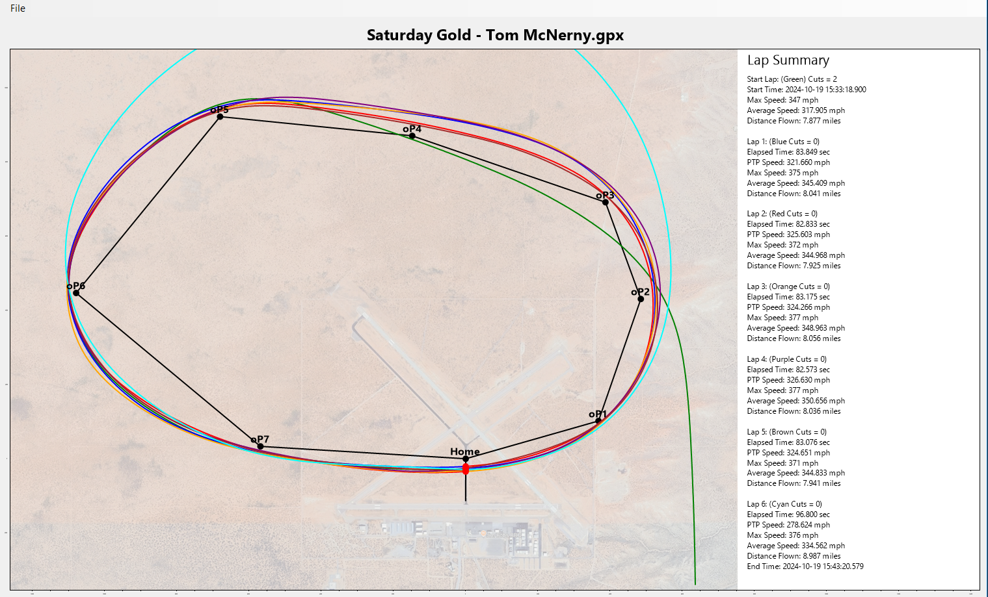

Slide 3
